Slide 1
IT1311 Decision Analysis Data-driven Decision Making 1
With/without probabilities

Slide 2
Introduction
Data-driven decision making can be used to determine an optimal strategy when a decision maker is faced with several decision alternatives and an uncertain pattern of future events
Several scenarios could be developed to describe how the various factors affect the future events
Probabilities can then be used to compute the potential profit or cost as a measure to select the best alternative

Slide 3
Approaches for Decision Making
Decision Making can be generalized into 2 approaches:
Decision Making
Without probabilities
Optimistic approach
With probabilities
Decision Tree
Conservative approach
MINIMAX approach
MAXIMAX
MAXIMIN
MINIMAX
REGRET

Slide 4
Decision Making without Probabilities
When the probability information is not available regarding the likelihood of the states of nature, we adopt the following 3 methods:
the optimistic approach
the conservative approach
the minimax regret approach
The states of nature refer to future events that may possibly occur.

Slide 5
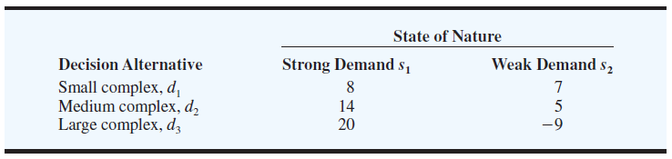
Scenario of the example
Pittsburgh Development Corporation (PDC) purchased a piece of land that will be used for the site of building a new luxury condominium complex.
PDC commissioned preliminary architectural drawings for three different projects: one with 30 (small complex) , one with 60 (medium complex), and one with 90 (large complex) condominiums.
The financial success of the project depends upon the size of the condominium complex and the demand for the condominiums.
The potential profits expressed in millions of dollars is shown below:

Slide 6
Optimistic Approach
For each decision the maximum payoff is listed and then the decision corresponding to the maximum of these maximum payoffs is selected
If the payoff was in terms of costs, the minimum costs would be determined for each decision and then the decision corresponding to the minimum of these minimum costs is selected
Payoff Table => MAXIMAX approach
Cost Table => MINIMIN approach
Maximax
decision

Slide 7
Conservative Approach
For each decision the minimum payoff is listed and then the decision corresponding to the maximum of these minimum payoffs is selected
If the payoff was in terms of costs, the maximum costs would be determined for each decision and then the decision corresponding to the minimum of these maximum costs is selected
Payoff Table => MAXIMIN approach
Cost Table => MINIMAX approach
Maximin
decision

Slide 8
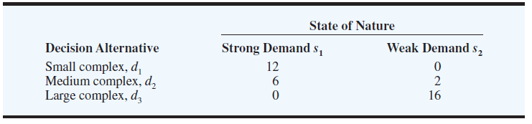
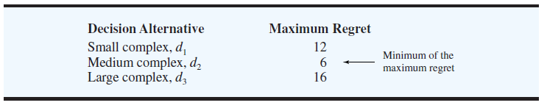
Minimax Regret Approach
For the minimax regret approach,
1. Compute a regret table by subtracting each payoff/cost in a column from the largest payoff / lowest cost in that column.
2. Then, for each decision list the maximum regret.
3. Choose the decision with the minimum of these values.
3.
Largest
payoff
Largest
payoff
Regret Table
(20 – 8)
(20 – 14)
(20 – 20)
(7 - 7)
(7 - 5)
(7 – (-9))
Max (12, 0)
Max (6, 2)
Max (0, 16)

Slide 9
Exercise 1
Consider the following payoff table:
What will be the recommendation using MAXIMAX, MAXIMIN, MINIMAX approach respectively?
Hint – use the information given and fill up this table.
 | State of nature (possible profit)
Decision alternatives | S1 | S2 | S3
D1 | 250 | 100 | 25
D2 | 100 | 100 | 75
Decision alternatives | Maximum Profit | Minimum Profit
D1
D2
Decision alternatives (Regret Table for MINIMAX) | S1 | S2 | S3
D1
D2

Slide 10
Exercise 1 (Answer)
Consider the following payoff table:
 | State of nature (possible profit)
Decision alternatives | S1 | S2 | S3
D1 | 250 | 100 | 25
D2 | 100 | 100 | 75
Decision alternatives | Maximum Profit | Minimum Profit
D1 | 250 | 25
D2 | 100 | 75
Optimistic approach (MAXIMAX) : select D1
Conservative approach (MAXIMIN): select D2
Decision alternatives (Regret Table for MINIMAX) | S1 | S2 | S3
D1 | 0 | 0 | 50
D2 | 150 | 0 | 0
Decision alternatives | Maximum Regret
D1 | 50
D2 | 150
Minimax regret approach :
select D1
10

Slide 11
Exercise 2 (Cost table)
A US company is deciding on the best decision to make in terms of choice of commute to send its employees on a working trip from California to Nevada. The trip could be made via airplane, train or simply by car.
The cost of each choice of transport varies according to the different states of nature, e.g. S1: where air traffic is smooth, travelling by air cost the company the least in terms of air tickets, hotel accommodation, worker’s morale etc. The cost table (in thousands of USD) is given below. What will be the recommendation using the optimistic, conservative and MINIMAX approach respectively?
States of nature
Modes of transportation | S1 | S2 | S3
Air | 20 | 60 | 40
Train | 25 | 30 | 40
Car | 35 | 50 | 25

Slide 12
Exercise 2 - working
States of nature
Modes of transportation | S1 | S2 | S3
Air | 20 | 60 | 40
Train | 25 | 30 | 40
Car | 35 | 50 | 25
Decision alternatives | Minimum Cost | Maximum Cost
Air
Train
Car
Optimistic: _________
Conservative: __________
Decision alternatives (Regret Table for MINIMAX) | S1 | S2 | S3 | Maximum Regret
Air
Train
Car
Minimax regret approach : __________
12

Slide 13
Exercise 2 - answer
States of nature
Modes of transportation | S1 | S2 | S3
Air | 20 | 60 | 40
Train | 25 | 30 | 40
Car | 35 | 50 | 25
Decision alternatives | Minimum Cost | Maximum Cost
Air | 20 | 60
Train | 25 | 40
Car | 25 | 50
Optimistic: _AIR____
Conservative: _TRAIN___
Decision alternatives (Regret Table for MINIMAX) | S1 | S2 | S3 | Maximum Regret
Air | 0 | 30 | 15 | 30
Train | 5 | 0 | 15 | 15
Car | 15 | 20 | 0 | 20
Minimax regret approach : __TRAIN____
13

Slide 14
Decision Making with Probabilities
In many decision making situations, we can obtain probability assessments for the states of nature
When such probabilities are available, we can use the expected value approach with decision trees to identify the best decision alternative

Slide 15

Example (PDC scenario)
The expected value of a decision alternative is the sum of weighted payoffs for the decision alternative.
PDC is optimistic about the potential for the luxury high-rise condominium complex
Suppose that this optimism leads to an initial subjective probability assessment of :
0.8 that demand will be strong (s1)
0.2 that demand will be weak (s2)
Thus, P(s1) 0.8 and P(s2) 0.2
EV(d1) = 0.8(8) + 0.2(7) = 7.8
EV(d2) = 0.8(14) + 0.2(5) = 12.2
EV(d3) = 0.8(20) + 0.2(-9) = 14.2

Slide 16
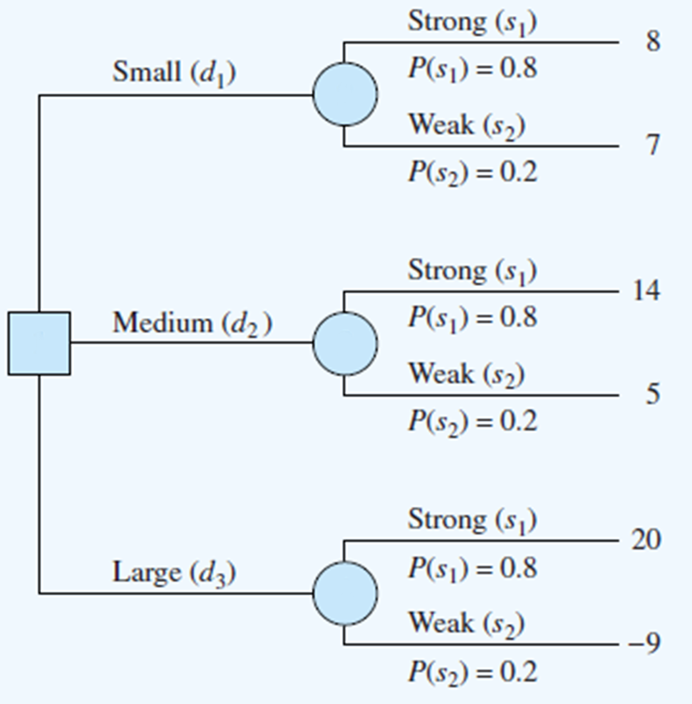
PDC Decision Trees
A decision tree is a chronological representation of the problem
Chance
Branches
EV(d1) = 0.8(8) + 0.2(7) = 7.8
EV(d2) = 0.8(14) + 0.2(5) = 12.2
EV(d3) = 0.8(20) + 0.2(-9) = 14.2
Event
Node
Decision
Node
Decision
Branches
Sum of P(s₁) and P(s₂) must be 1

Slide 17
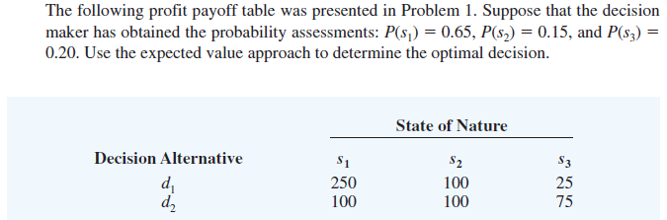
Exercise 3
(From reference text, Chapter 4 , Q5 , page 133)
(Hint – first draw the decision tree and then compute the EV.)

Slide 18
Exercise 3 - working
P(s1) = 0.65
P(s2) = 0.15
P(s3) = 0.20

Slide 19
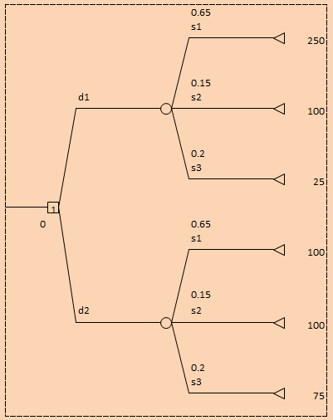
Exercise 3 - answer
EV(d1) = 0.65(250) + 0.15(100) + 0.20(25) = 182.5
EV(d2) = 0.65(100) + 0.15(100) + 0.20(75) = 95
The optimal decision is d1

